Slide 1



Secure Retrieve Work Item
(SeR)
Presented by Martin Smock,
IHE Switzerland

Slide 2
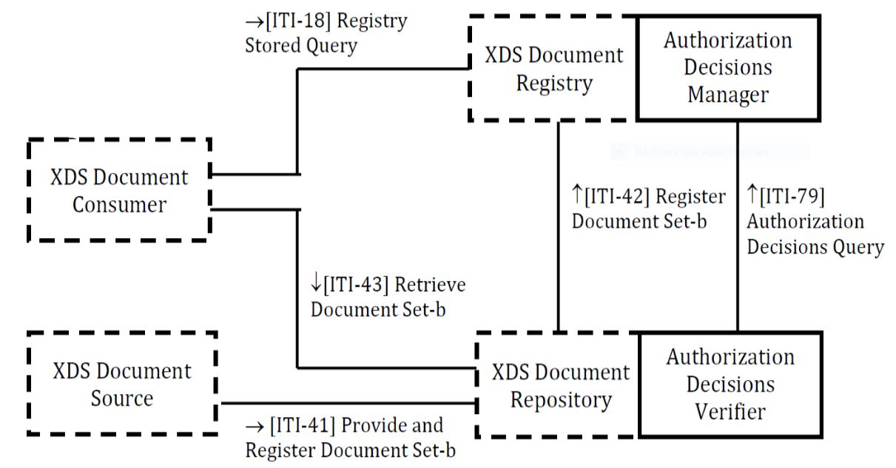
Work Item
SeR Trial Implementation Revision 1.6 defines a mechanism for XDS Repositories to delegate authorization decisions to a centralized Authorization Decision Manager.
Using SeR the XDS Repository no longer needs to implement the logic required for authorization of document retrieval but can request the Authorization Decision Manager for the decisions.
This simplifies the implementation of XDS Repositories, especially if the authorization rules are complex.

Slide 3
Work Item
Since the authorization decision delegation has advantages for other actors in a health sharing domain, the aim of the work item was to open future versions of the SeR Trial Implementation for other actors in a health sharing infrastructure.
The changes address:
Define an extension point for national extensions to extend the profile for other actors and use cases.
Keep the frame of standards for the SAML and XACML transport and message protocols.
Keep downward compatibility to support the document retrieval use case.

Slide 4
Motivation
The changes a driven by requirements of national EPR for a centralized authorization, e.g. the Swiss national EPR.
In the Swiss EPR the rules for building access decisions are complex due to legal requirements and a centralized Authorization Manager is the preferred solution.
Actors are required to enforce the access decisions made by the Authorization Decision Manager, e.g. the:
XDS.b Document Registry
PIX Manager (PIX V3)
Healthcare Provider Directory (HPD)
An extension to use the Authorization Manager for FHIR based Profiles is planned, e.g. MHD, PIXm and mCSD.

Slide 5
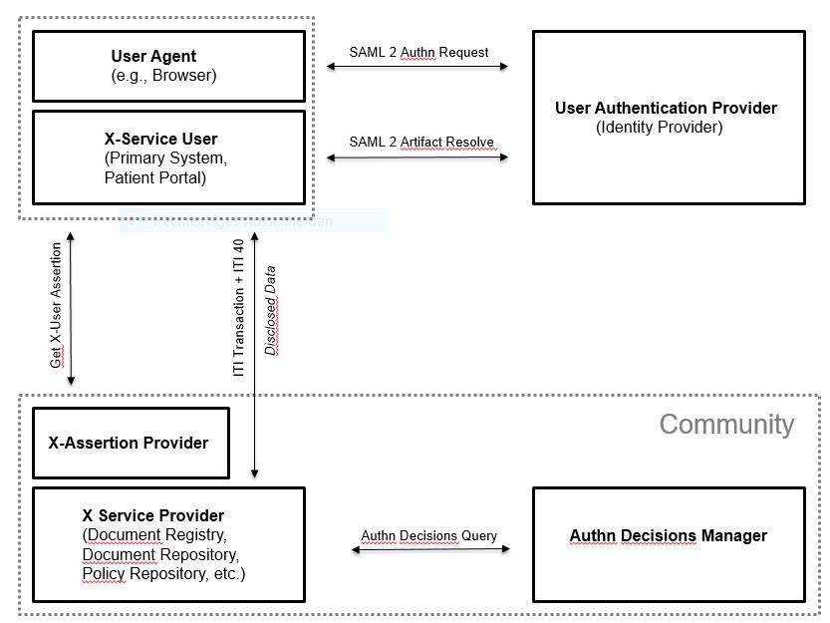

Slide 6
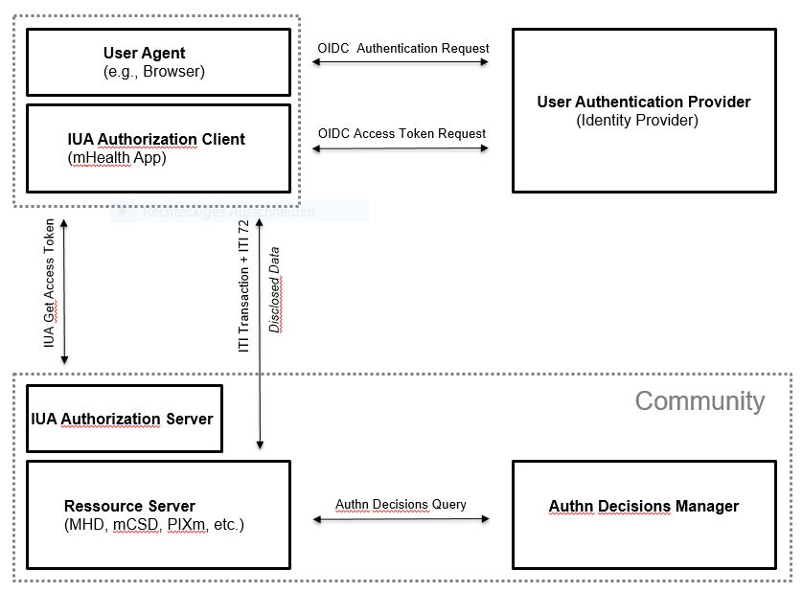

Slide 7
Breaking Changes
We removed the restriction of applicability to the XDS Retrieve Document Set transaction.
We adapted the required grouping and grouping of the Authorization Decision Manager with the XDS Registry is changed from mandatory to optional.
We adapted the text to remove the restrictions limiting the applicability to XDS Retrieve Document Set.
We opened SeR for national extensions
We added a query type mechanism well known from the Registry Stored Query [ITI-18].
National extensions may now define query types which match the national requirements.
We ensured downward compatibility by using the XDS Retrieve Document Set case as the default query type.

Slide 8
Thank you.
We are looking forward to your comments and change request in this public comment phase.

